Slide 1
South Weber City Council Update
Shannon Smith and Mark Roginske
8 May 2018

Slide 2
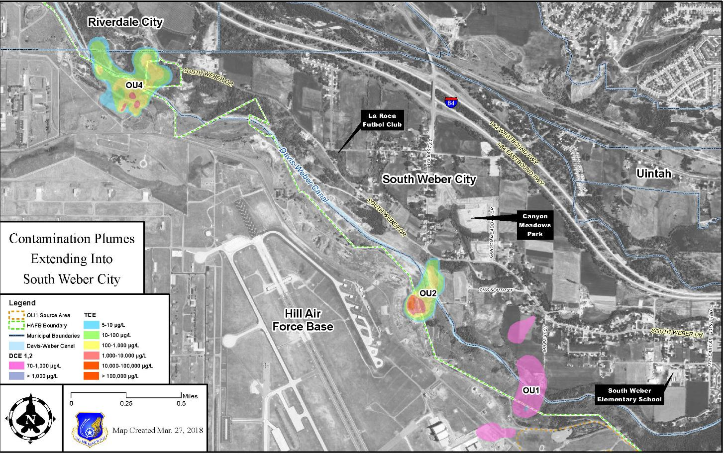
Areas of Contamination

Slide 3
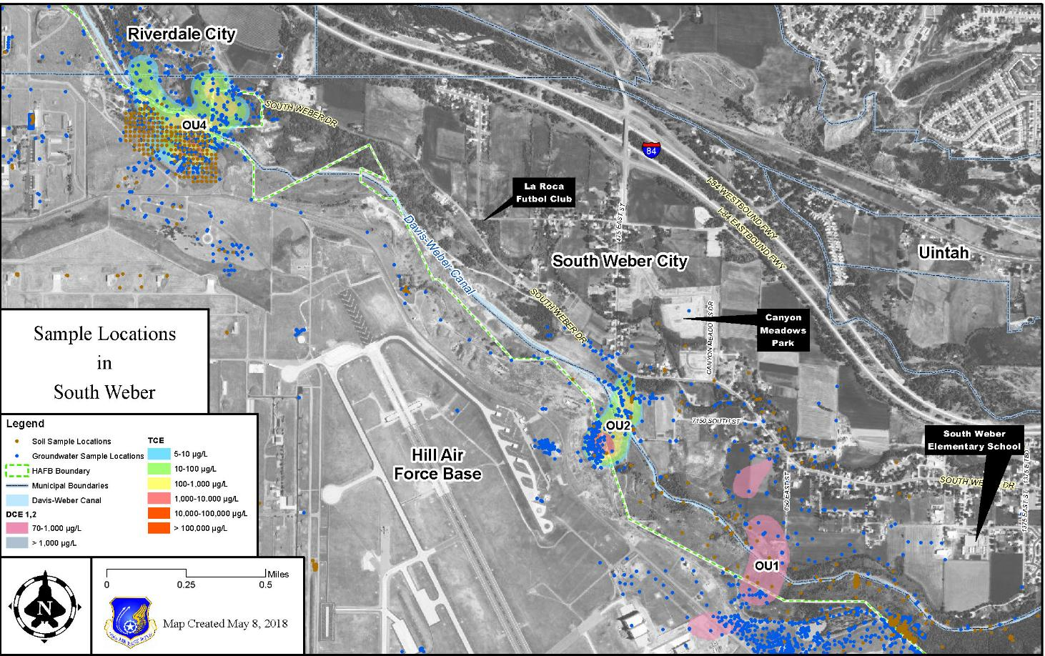
South Weber Sample Locations

Slide 4
Overview
Operable Units 1, 2 & 4
  Areas of Contamination & Treatment Systems
  Cleanup Progress /Timeframe
  Protectiveness of Cleanup Remedy
Indoor Air Sampling Program
Items to Note:
Drinking water is not contaminated
  Contamination found in shallow groundwater
  Cleanup levels are based on drinking water standards
All remedies are agreed upon by the Air Force, EPA Region 8 & Utah Dept. of Environmental Quality (UDEQ)
Part per billion – The number of parts per one billion parts of something
Common examples of one part per billion
  One penny in $10M
  One grain of salt in 115 boxes
  One drop of water in a typical backyard swimming pool

Slide 5
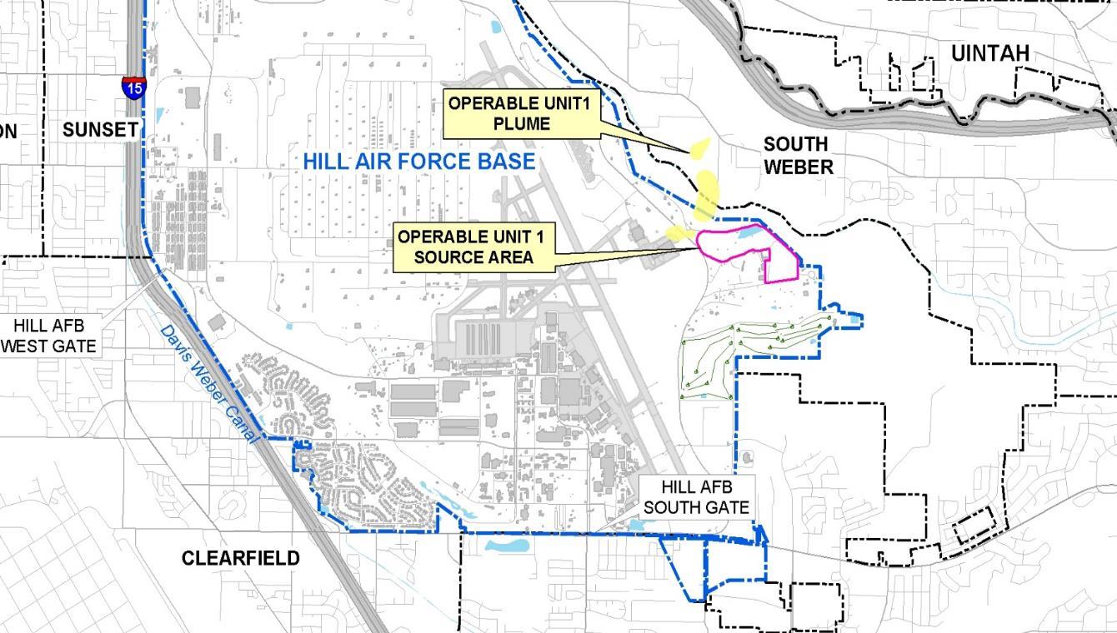
Operable Unit 1

Slide 6
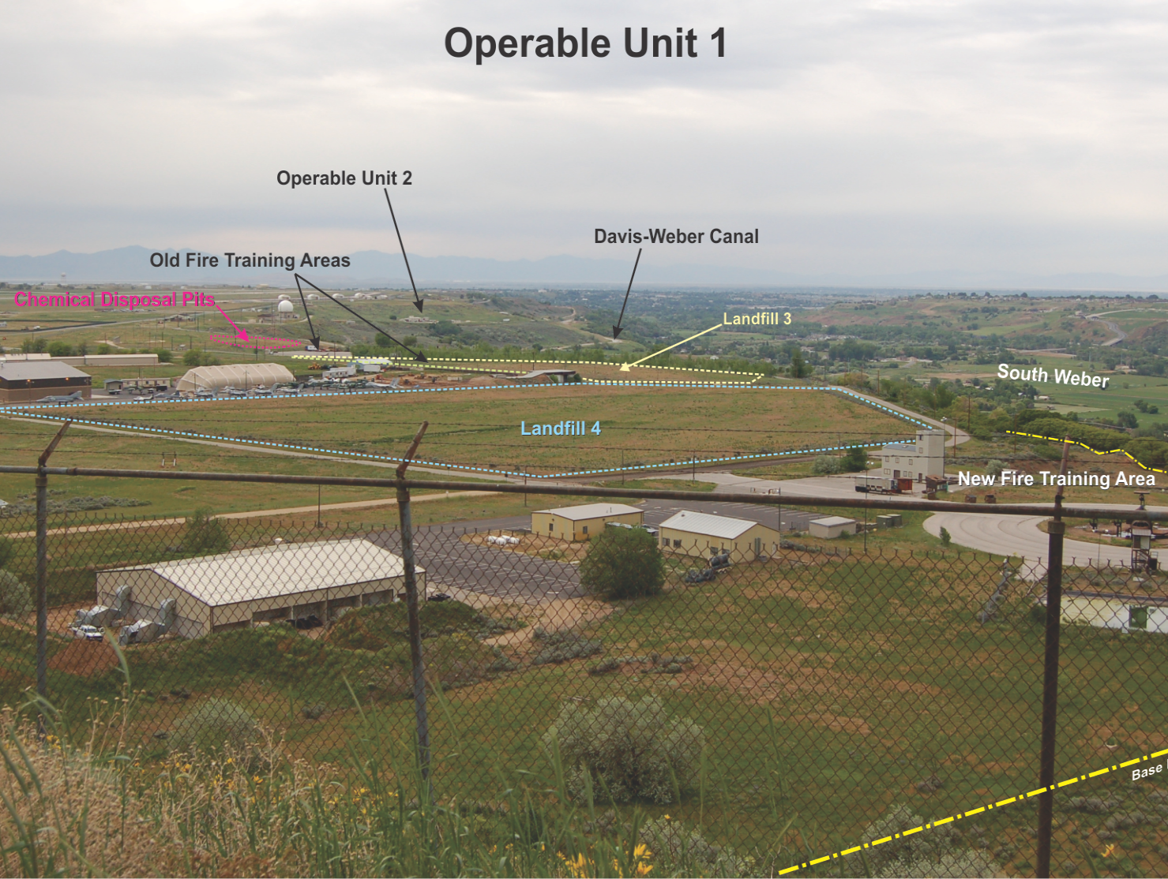
Contaminant of Concern
(cis)1,2-Dichloroethene (DCE)
Breakdown product of trichloroethene (TCE)
Non-carcinogenic – not shown to cause cancer
Most widespread contaminant – all other contaminants fall within the footprint of DCE plume
Cleanup standard of 70 parts per billion
Source areas
– located on base
– cover about 64 acres
Notes:
Other contaminants are present in the plume but the DCE plume is the largest and encompasses the other contaminants. The plume map is a visual aid and allows us to show the footprint of the contamination.

Slide 7
Actions & Remedies at OU1
Record of Decision signed in 1998
Install groundwater collection trenches around source areas
  To capture contaminated groundwater and fuels floating on top of groundwater preventing migration of contaminants off-base
    265 million gals of contaminated groundwater captured
    19,200 gals of fuel removed
    Trenches have a 98% capture efficiency
Institutional controls – to limit any potential exposure
  Prevent exposure at off-Base springs – fencing and signs
Improve and expand landfill caps on-Base
  Prevent surface water from entering landfill
Notes:
ROD – signed by all parties. States what remedies the AF will install and what objectives each is trying to achieve and the end goal. Goals: Prevent exposures, prevent migration, prevent further contaminating the waters of the state.
2% that is escaping is not adding significant amounts to the plume because we see the plume shrinking. If concentrations were increasing or the plume was expanding we would re-evaluate the remedy.

Slide 8
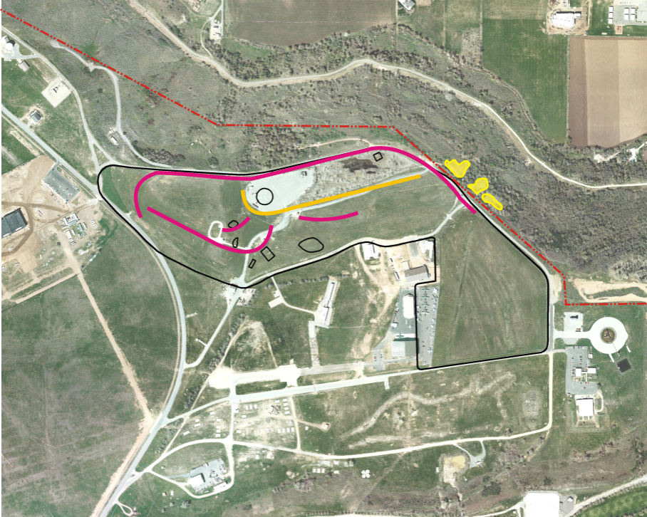
Actions & Remedies at OU1
Groundwater Extraction Trench
Arsenic Soil Removal areas
Landfill Cap

Slide 9
Actions & Remedies at OU1
Remove contaminated sediments around off-Base springs when flows stop
    To prevent exposure above acceptable risk range (>11 mg/kg)
      Removed 1,550 cubic yards of arsenic contaminated soil
      Steep hillside made further excavation unsafe
      Remaining arsenic does not pose a human health risk
Monitor natural attenuation rates in plume
    Allow plume to break down naturally
    Concentrations measured periodically
      Data used to draw areal extent of plume
      Data used to evaluate concentration changes in monitoring wells
    Plume is shrinking

Slide 10
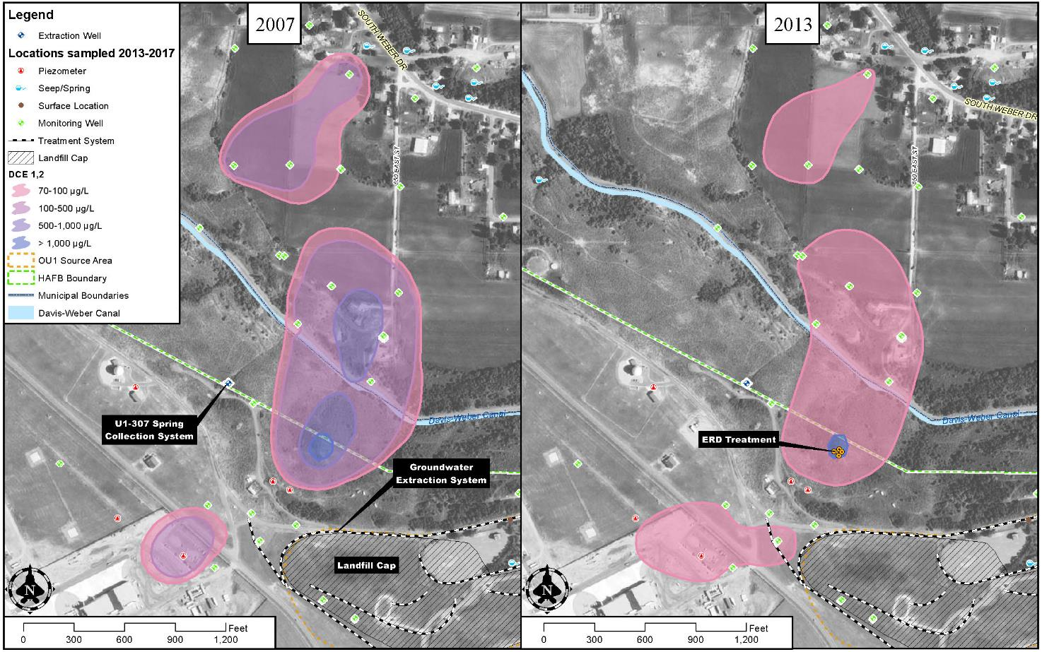
OU1 Cleanup Progress

Slide 11
OU1 Cleanup Timeframe
At ROD signing, cleanup timeframe for plume uncertain (range: 5 to 50 years) but estimated at 12 years
  That was a bad estimate!
  Limited information and limited understanding of how natural attenuation works
Current plume cleanup estimated in 2040s
  Based on observed data
  More information = Better estimate
Understanding of the site continually improves as we gather more information …
  More accurate now than in 1990s …
  Will be more accurate in 2020s than now

Slide 12
Is OU1 Remedy Protective?
Remedies control the source areas
    Groundwater Extraction System
    Landfill caps
Restrictions on groundwater use
    Manages any potential for exposure
Ongoing groundwater monitoring
    Tracks progress and effectiveness of remedies
Five-Year Reviews (FYR)
  Using the results of the health risk assessment presented in the ROD as a baseline – Asks the question, “Are the treatment systems preventing exposures which could lead to a health risk (i.e. are the remedies protective)?”
    2013 review found the remedy was protective
    2018 review under way

Slide 13
Operable Unit 2
Operable Unit 2
OU 1

Slide 14
OU2 Source Area
1967 – 1975: Disposal of an estimated 50,000 gallons of solvents
Primary Contaminant of Concern – Trichloroethene (TCE)
  a degreaser historically used at Hill AFB
  Carcinogenic – can cause cancer
  Most widespread contaminant – all other contaminants fall w/in footprint of the TCE plume
  Cleanup standard is 5 parts per billion
Chemical Disposal Pit
Hill AFB Boundary
Davis-Weber Canal
Impacted Area: 5 acres on-base, 19 acres off-base

Slide 15
Actions and Remedies
– ROD 1996
Containment Wall
To prevent groundwater from flowing in & out of source area
Extraction Wells
To prevent groundwater from flowing in & out of source area
Air Stripper (SRS)
To treat extracted groundwater prior to discharge to sewer
Interceptor Trench
To intercept contaminated groundwater to prevent further plume expansion
Seep Intercept System
To collect seep water and discharge to sewer
Systems have removed:
– 253M gal groundwater
– 44,400 gal of solvent

Slide 16
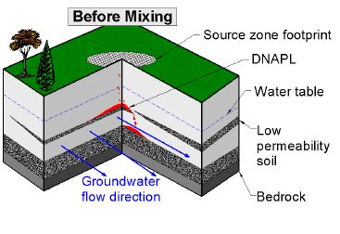
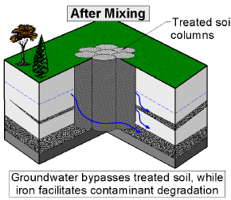
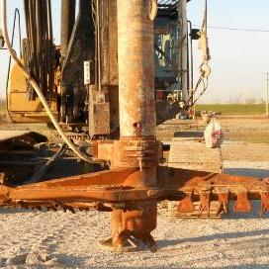
Additional Actions 2016-2017
Source Area Soil Mixing
– Zero-Valent Iron (ZVI) & Clay
– Mixed into subsurface using large auger
– Clay binds contaminants & reduces groundwater flow through treated area
– ZVI treats contaminants
– If successful, could be used in remaining source area
Biobarriers
– Subsurface injections of vegetable oil to speed up natural degradation of contaminants
– 99% reduction in concentrations
– Reduction in remedial timeframe ~ 25yrs

Slide 17
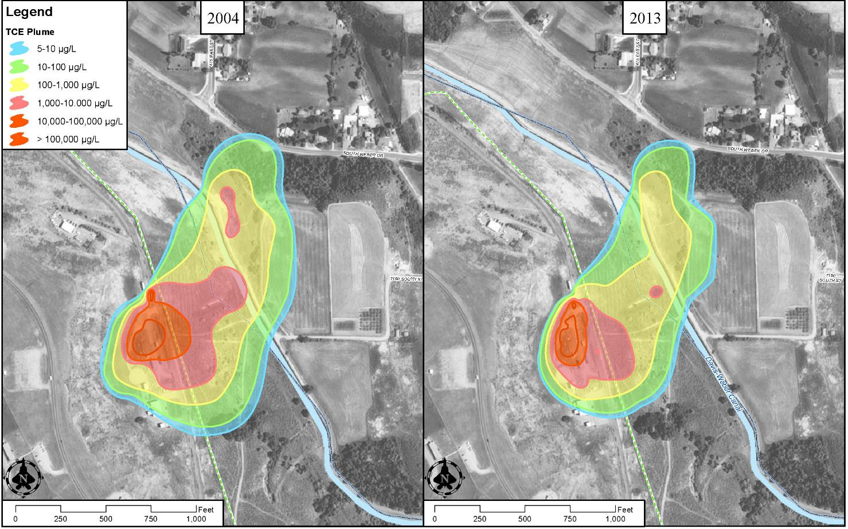
OU2 Clean Up Progress

Slide 18
OU2 Cleanup Timeframe
1996 ROD stated, cleanup timeframe estimated…
  15 to 30 years
  “…complex hydrogeology makes it difficult to estimate…”
Current plume cleanup estimated in 2100s
  Based on observed data
  More information = Better estimate
  Additional source area actions could reduce cleanup timeframe

Slide 19
Is OU2 Remedy Protective?
The remedies control source area
    Groundwater Extraction System w/ Upgradient Collection Trench
    Containment Wall
Restrictions on groundwater use
    Manages any potential for exposure
Ongoing groundwater monitoring
    Tracks progress and effectiveness of remedies
Five-Year Reviews
  Are the treatment systems preventing exposures? Are the remedies protective?
    2013 review found the remedy was protective
    2018 review under way

Slide 20
Operable Unit 4

Slide 21
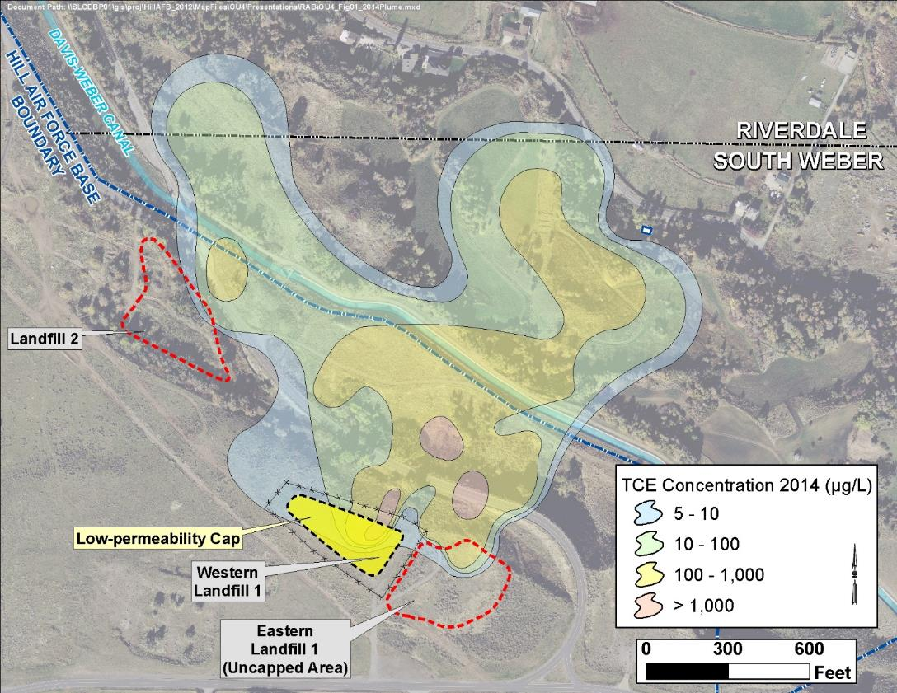
OU 4 Source Areas and Background
– TCE is primary Contaminant of Concern
– TCE plume has not significantly expanded since 1994 ROD
– Overall, concentrations have remained fairly constant
– Extent: 32 acres

Slide 22
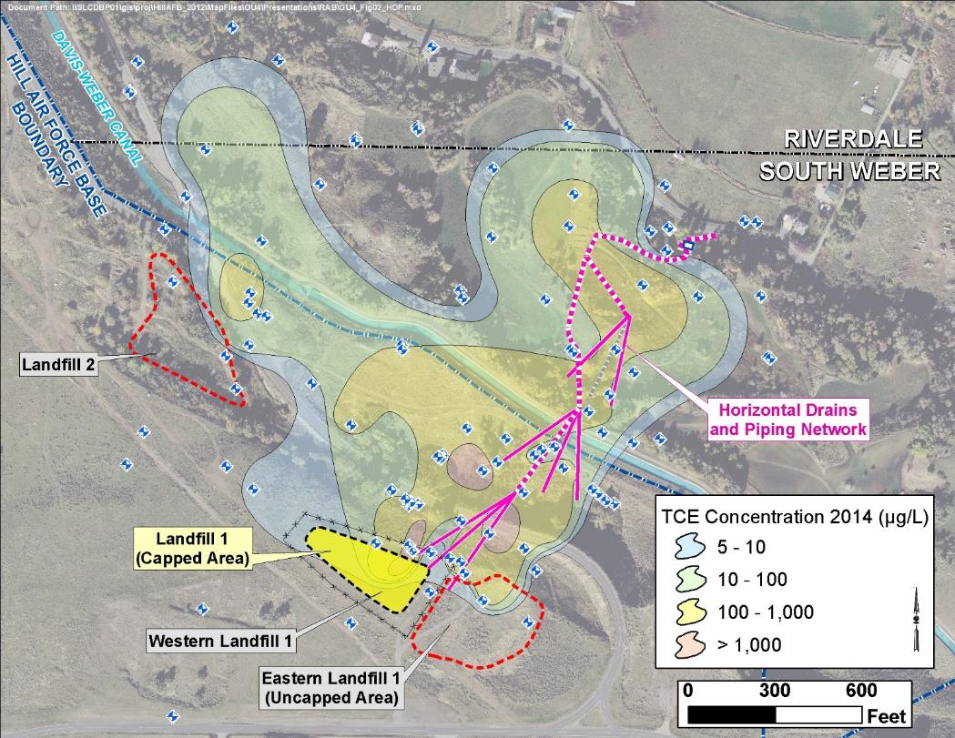
Remedies – ROD 1994
Low-permeability cap installed at Landfill 1 – to limit water infiltration and movement of contaminants from beneath landfill cap
Horizontal Drain Network - a passive groundwater collection system to remove contaminated groundwater and discharge to sanitary sewer
Groundwater monitoring - to ensure cleanup goals are being met

Slide 23
Existing Remedy Performance
2013 Five-Year Review
  Current remedy is not functioning as intended but remains protective in the short-term.
Landfill 1 cap
  Likely limits infiltration of surface water
  Seeing increase in TCE concentrations in groundwater downgradient of Landfill 1
  Landfill 1 contents - ongoing source of TCE contamination
Horizontal Drains
  Extracted 42 million gal of groundwater
  Works but is not reducing cleanup timeframe
Uncapped portion of Landfill 1 and Landfill 2 also identified as on-going TCE source areas

Slide 24
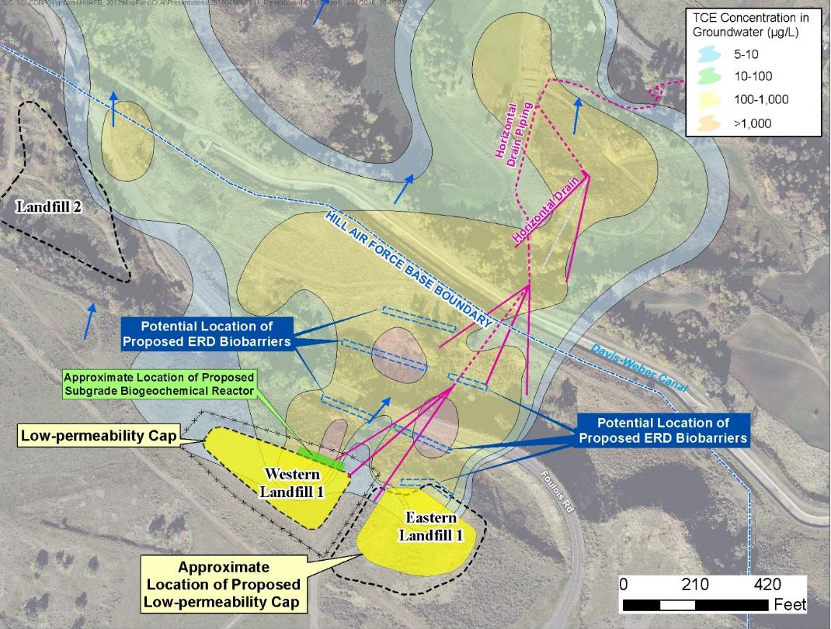
Expanded Remedy – 2017
ROD Amendment signed 2017 to implement additional remedies
Bioreactor downgradient of Landfill 1 – series of column bioreactors
Low-permeability cap on Eastern Landfill 1
Biobarriers – core of plume and downgradient of new landfill cap
More work needs to be done at Landfill 2
– Collect additional samples
– Evaluate treatment alternatives

Slide 25
OU 4 Cleanup Timeframe
1994 ROD stated…
  Cleanup timeframe greater than 30 yrs (or 2020s)
  We now know it is longer
  TCE is continuing to source to groundwater
  More work needs to be done at Landfill 2
    – Complete site characterization
    – Evaluate treatment alternatives
Current plume cleanup estimated in 2080s
  Based on 2017 ROD Amendment with Expanded Remedy

Slide 26
Is OU 4 Remedy Protective?
The remedy controls source areas
    Landfill Caps – improved with the additional cap
    Groundwater Collection Trenches
Restrictions on groundwater use
    Manages any potential for exposure
Ongoing groundwater monitoring
    Tracks progress and effectiveness of remedies
Five-Year Reviews
  Are the treatment systems preventing exposures? Are the remedies protective?
    2013 review found the remedy was protective in the short-term
    2018 review under way

Slide 27
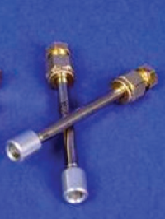
Vapor Intrusion (VI) in Operable Units 1, 2, and 4
At OUs 1 and 2:
  VI is not from traditional evaporation from groundwater pathway
  VI is from sewer line receiving TCE-contaminated groundwater from on-base treatment system
At OU 4:
  No significant VI is occurring
Action levels are established for each chemical with EPA and UDEQ approval
South Weber Drive

Slide 28
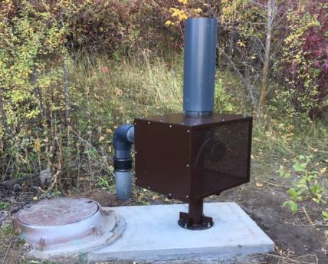

Slide 29
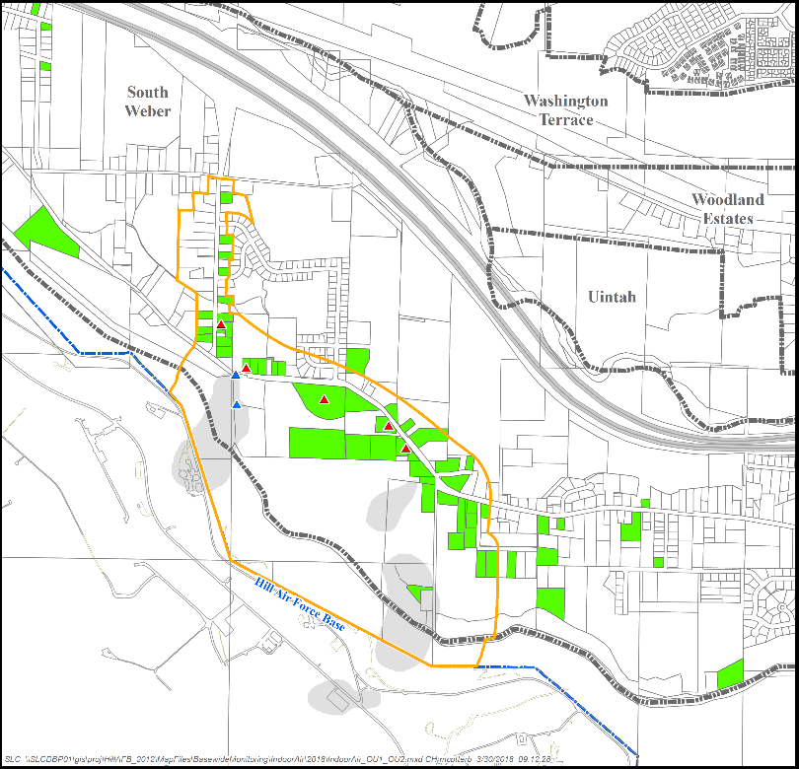
2016/2017 Air Sampling Results
Total Locations Sampled:
61 homes in affected area
61 homes sampled since 2003 (many outside current affected area)
7 homes agreed to sample in 2016-2017 event
Historical Sampling Results:
4 homes with detections above action level
57 homes with results below action level
Mitigation Systems:
1 sewer vent fan installed in January 2017
1 sewer vent fan installed in February 2011
5 homes have vapor intrusion mitigation systems
In 2016-2017 Sampling Event:
No homes with detection above action level

